Slide 1

Note: The data and information in this document is reflective of a hypothetical situation and client. This document is to be used for KPMG Virtual Internship purposes only.
Sprocket Central Pty Ltd
Data analytics approach
KPMG Virtual Internship, Deepika Bhatt, Intern

Slide 2
Note: The data and information in this document is reflective of a hypothetical situation and client. This document is to be used for KPMG Virtual Internship purposes only.
Agenda
Introduction
Data Exploration
Model Development
Interpretation

Slide 3
Note: The data and information in this document is reflective of a hypothetical situation and client. This document is to be used for KPMG Virtual Internship purposes only.
Introduction
PROBLEM STATEMENT
Transaction data, Customer Demographic, Customer Address
Customer Segmentation
Select high value customers from the given 1000 new customer list

Slide 4
Note: The data and information in this document is reflective of a hypothetical situation and client. This document is to be used for KPMG Virtual Internship purposes only.
Introduction contd..
DATA EXPLORATION
Data quality check
Cleaning data
MODEL DEVELOPMENT
Calculating metrics (RFM)
Clustering of customers
INTERPRETATION
Segment customers into Platinum, Gold, Iron & Lead
Use this segmentation to list out high value customers
Data wrangling
EDA
APPROACH & METHODOLOGY

Slide 5
Note: The data and information in this document is reflective of a hypothetical situation and client. This document is to be used for KPMG Virtual Internship purposes only.
Data Exploration
Quality Check
Quality Check | Problem | Solution and Recommendation
Accuracy | Valid ‘DOB’ should be given | For now, I have removed the data point with invalid DOB
Completeness | ‘last name’ was missing in almost 3.125% of data. Variable ‘DOB’ in the Customer Demographic table is also missing in around 2.175% of data. Columns "job_title" and "job_industry_category" have sizeable numbers of null values (12.65% & 16.5% respectively). Almost 2.175% data is missing in the column ‘Tenure’ in the Customer Demographics Table. | Since ‘DOB’ is an important variable, therefore, it would be better if you could provide all the missing DOB. If not, then for the analysis purpose, we will drop the data point with the missing DOB. Since these are categorical columns, therefore our approach will be to define another category to replace these.
Consistency | Column ‘gender’ in the Customer Demographics table has been defined in different ways. All the variables should have consistency in terms of type of data. | I have defined the gender as Female and Male. In future please create a drop-down list for such variable to avoid inconsistency. I have also modified the data type of the variables as required. In future, take the input in the required data type.

Slide 6
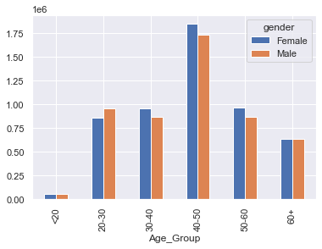
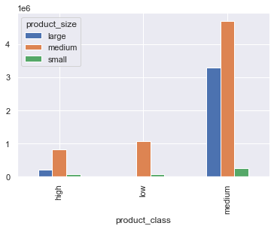
Note: The data and information in this document is reflective of a hypothetical situation and client. This document is to be used for KPMG Virtual Internship purposes only.
Data Exploration Contd..
EDA (Profit Analysis)
Age group 40-50 is generating maximum profit irrespective of the gender.
Data shows that medium product class with medium product size gives maximum profit.

Slide 7
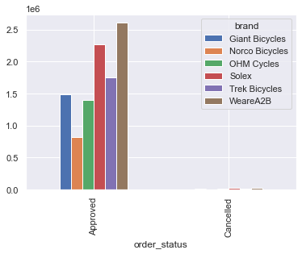
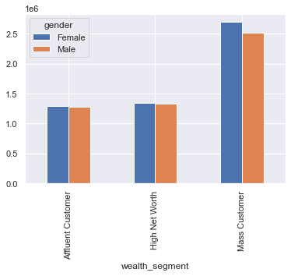
Note: The data and information in this document is reflective of a hypothetical situation and client. This document is to be used for KPMG Virtual Internship purposes only.
Data Exploration Contd..
EDA (Profit Analysis)
The order status for almost all the transactions is in the approved category.
Data shows that maximum profit is coming from brand “weareA2B”.
In the wealth_segment we can observe that the mass customer category is giving the maximum profit irrespective of the gender.

Slide 8
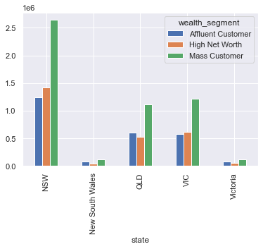
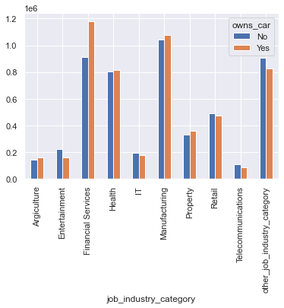
Note: The data and information in this document is reflective of a hypothetical situation and client. This document is to be used for KPMG Virtual Internship purposes only.
Data Exploration Contd..
EDA (Profit Analysis)
Maximum profit is generating from the state NSW.
Within the NSW state, the “Mass customer” category is generating the maximum profit.
Customers working in the financial service job industry category are generating maximum profit followed by the manufacturing category.

Slide 9
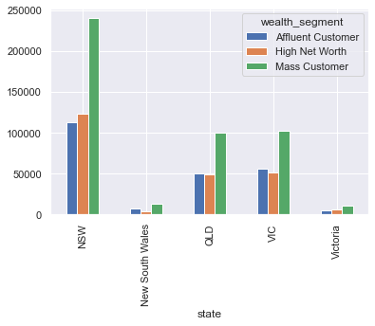
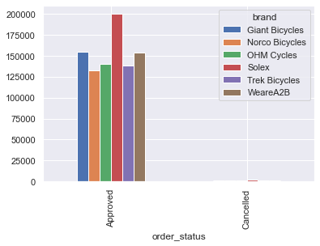
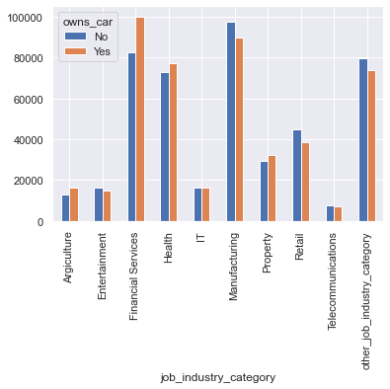
Note: The data and information in this document is reflective of a hypothetical situation and client. This document is to be used for KPMG Virtual Internship purposes only.
Data Exploration Contd..
EDA (Past 3 years bike related purchased analysis)
Customers from state NSW in the category of Mass Customer wealth segment have done maximum number of transactions for the bike related purchase.
In the past 3 years, the maximum number of brand item sold are from the Solex category.
Customer who own a car and work in the financial services have done maximum number of bike related purchase in the past 3 years. However, customers working in the manufacturing job have also done substantial number of purchases irrespective of whether they own car or not.

Slide 10
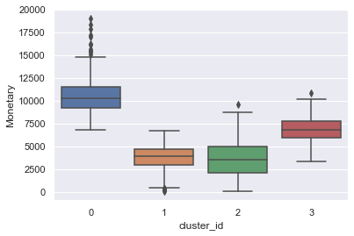
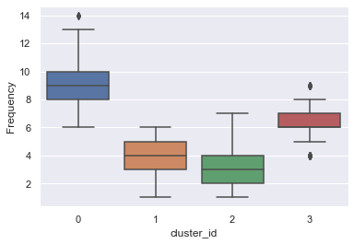
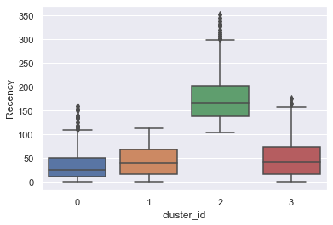
Note: The data and information in this document is reflective of a hypothetical situation and client. This document is to be used for KPMG Virtual Internship purposes only.
Model Development
Clustering Customer on the basis of RFM
Culster_id 0 have customers with high monetary value, high frequency and low recency.
Cluster_id 1 have customers with low monetary value, low frequency and low recency.
Customer_id 2 have customers with high monetary value and high frequency in comparison to cluster_id 1 and recency high among all the clusters.
Cluster_id 3 have customers with medium monetary value, medium frequency and medium recency.

Slide 11
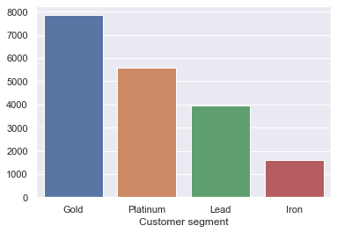
Note: The data and information in this document is reflective of a hypothetical situation and client. This document is to be used for KPMG Virtual Internship purposes only.
Interpretation
Customer Segmentation
Maximum number of customers are under the Gold segment followed by the Platinum.
Platinum segment customers have high monetary value, high frequency and low recency, therefore, the company should target the customers under platinum segment.
Cluster_id | Segment
0 | Platinum
1 | Lead
2 | Iron
3 | Gold

Slide 12
Note: The data and information in this document is reflective of a hypothetical situation and client. This document is to be used for KPMG Virtual Internship purposes only.
THANK YOU

